Slide 1


Catching ⬆️: C++ Unicode
Part 2 of 5 | Into the Details
JeanHeyd “ThePhD” Meneide Meeting C++ 2019 Saturday, November 16th, 2019

Slide 2
Recap
A Living Body of Work

Slide 3
C++ Unicode Support Includes:

Slide 4
C++ Unicode Support Includes:
[ This Space Intentionally Left Blank ]

Slide 5
char is not your friend
std::string totally_utf8(u8“柴”); std::string also_totally_utf8(“柴”); assert(totally_utf8 == also_totally_utf8); // 😂

Slide 6
char is not your friend
40,000 Lines into your codebase…
void process(std::string definitely_utf8); process(u8“Jí pes bagetu?”); // okay process(“jedna koruna česká”); // uhh ... process(argv[1]); // ⚠️!!

Slide 7
char8_t Introduced for C++20
New fundamental type
Turns ambiguity into hard compiler errors
std::u8string totally_utf8(u8“柴”); std::string also_totally_utf8(“柴”); assert(totally_utf8 == also_totally_utf8); // ❌

Slide 8

unsigned char: savior before C++20
Allows you to get hard compiler errors, early
using u8string = std::basic_string<unsigned char>;
🌺Blossom🌺changes out to program boundaries
Explicitly encode/decode or mark when going from/to std::string

Slide 9
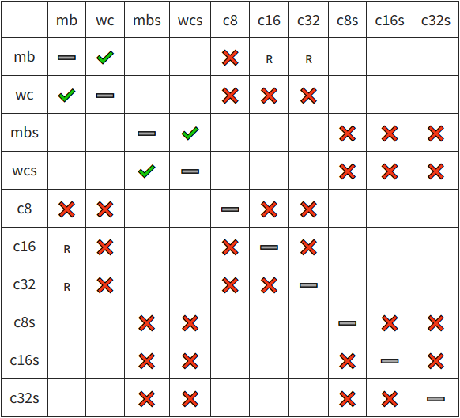

C Standard: Busted

Slide 10
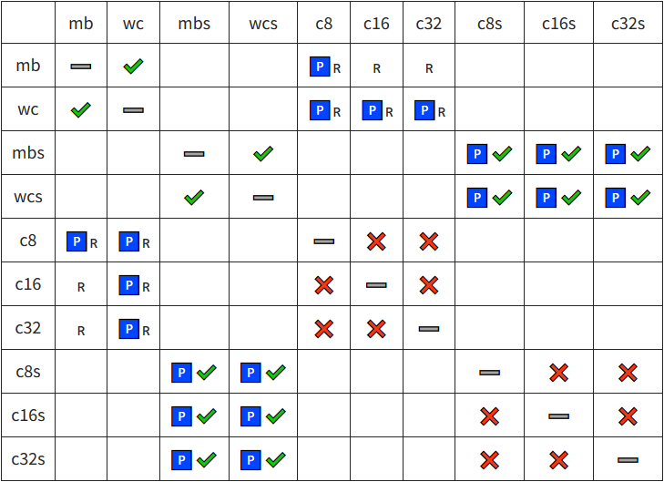

Nearly Unanimous Consensus: Fix iT!
N2440 - https://thephd.github.io/vendor/future_cxx/papers/source/n2440.html

Slide 11
Sized Functions, Too!
n-style of C functions
size_t mbsnrtocXs(charX_t* restrict dest, const char** restrict src, size_t dest_len, size_t src_len, mbstate_t* restrict state);
Allows:
usage of embedded nulls in data
SIMD optimizations, even on exotic architectures

Slide 12
[[sidebar]] rsize
“There were sized conversion functions in the C Standard Already!”
Referring to: Annex K
RSIZE_MAX – implementation defined, “should be (SIZE_MAX / 2)”!
“Implementations will do the right thing!”

Slide 13


Slide 14
[[Sidebar]] Theorem: There is Always a Death Station 9000
Corollary: there exists a Hell++
Always

Slide 15
[[End Sidebar]]

Slide 16
C Standard: Making Progress
WG14 C Standard General Rules:
There should be at least 2 implementations
It should build on existing practice
Implementation in the Small Device C Compiler (SDCC)
Plus, freestanding in-progress library with cuneicode
musl and glibc next, soon?

Slide 17
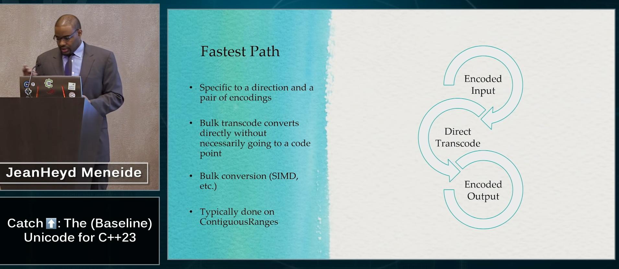
Current Progress
Status Report on the Advancements

Slide 18
Encoding Concept
Core Abstraction: represents an encode/decode pairing
Typedefs describe behavior
Requires:
3 Typedefs (state, code_point, code_unit)
2 Static Member Variables (max_code_points, max_code_units)
2 Functions (encode_one, decode_one)

Slide 19
Helper Types
struct empty_struct {}; using byte_span = std::span<std::byte>; using u8_span = std::span<char8_t>; using u16_span = std::span<char16_t>; using u32_span = std::span<char32_t>;
enum class encoding_errc : int { ok = 0x00, invalid_sequence = 0x01, insufficient_output_space = 0x02, };

Slide 20
Helper Types: Results
struct decode_result { u8_span input; u32_span output; empty_struct& state; encoding_errc error_code; bool handled_error; };
struct encode_result { u32_span input; u8_span output; empty_struct& state; encoding_errc error_code; bool handled_error; };

Slide 21
Helper Types: Error Callbacks
using decode_error_handler = std::function_ref< decode_result(utf8&, decode_result, u8_span) >; using encode_error_handler = std::function_ref< encode_result(utf8&, encode_result, u32_span) >;

Slide 22
Encoding Objects
struct utf8 { using code_unit = char8_t; using code_point = char32_t; using state = empty_struct; static constexpr inline std::size_t max_code_points = 1; static constexpr inline std::size_t max_code_units = 4; encode_result encode_one(u8_span input, u32_span output, state& current, encode_error_handler error_handler); decode_result decode_one(u32_span input, u8_span output, state& current, decode_error_handler error_handler); };

Slide 23
Encoding Objects
struct utf16 { using code_unit = char16_t; using code_point = char32_t; using state = empty_struct; static constexpr inline std::size_t max_code_points = 1; static constexpr inline std::size_t max_code_units = 2; encode_result encode_one(u16_span input, u32_span output, state& current, encode_error_handler16 error_handler); decode_result decode_one(u32_span input, u16_span output, state& current, decode_error_handler16 error_handler); };

Slide 24
Encoding Objects
struct gb18030 { using code_unit = std::byte; using code_point = gb_code_point; // !! using state = empty_struct; static constexpr inline std::size_t max_code_points = 1; static constexpr inline std::size_t max_code_units = 4; encode_result encode_one(byte_span input, std::span<gb_code_point> output, state& current, encode_error_handlergb error_handler); decode_result decode_one(std::span<gb_code_point> input, byte_span output, state& current, decode_error_handler error_handler); };

Slide 25
Change in Code Point?!
GB18030 is a Unicode Transformation Format (UTF)
Mandated by the PRC
But it stores information differently:
Uses Private Use Area (PUA) characters as well

Slide 26
Strong Code point Types
Explored in Tom Honermann’s text_view
Helps emphasize each encoding might have its own “character set”
Industry players have written dissents against such a design
phd::text allows it
Cost: layers above encoding expecting char32_t fail without conversion

Slide 27
Preventing Consequences
Failure to roundtrip data if it is not convertible to char32_t
struct gb_code_point { /* … */ operator char32_t () const; // whew, okay… };

Slide 28
Do We Need Strong Code points?
Strong Code Points?
Is char32_t enough?
Handling it in higher levels of code?
Better Character Sets?
Strong encoding ⬄character collection association

Slide 29
Standard Encodings
template <typename Char> class basic_utf8; template <typename Char> class basic_utf16; template <typename Char> class basic_utf32; class ascii; class narrow_execution; class wide_execution; using utf8 = basic_utf8<char8_t>; using utf16 = basic_utf16<char16_t>; using utf32 = basic_utf32<char32_t>;

Slide 30

Any_encoding
RUNTIME ENCODING STORAGE

Slide 31

Runtime-Only Encoding Decisions
Extremely Common
<meta charset=“UTF-8”>
Byte Order Marks
Robust document processing
Data exchange formats

Slide 32
struct any_encoding { using code_unit = std::byte; using code_point = char32_t; using state = …; static constexpr inline std::size_t max_code_points = 4; static constexpr inline std::size_t max_code_units = 16; template <typename Encoding> any_encoding(Encoding&& some_encoding); encode_result encode_one(byte_span input, u32_span output, …, encode_error_handler error_handler); decode_result decode_one(u32_span input, byte_span output, …, decode_error_handler error_handler); };

Slide 33
any_encoding
Value-type wrapper around polymorphic storage
Typical abstract internal base class with typed implementation;
Internally, strengthen with Small Size optimization
Most encodings are stateless or empty, but…

Slide 34
execution, wide_execution
Contains data:
std::mbstate_t
Shared multibyte state type for char/wchar_t encodings
struct wide_state { std::mbstate_t extra_space; };

Slide 35
Static Types ☢️Type-erasure
Implicit assumption in some parts of the library:
using some_state = encoding_state_t<SomeEncoding>; some_state fresh_state{}; // create a fresh state to work on old_state = some_state{}; // overwrite old state to “start new”

Slide 36
Oh Geez.
struct any_encoding { using code_unit = std::byte; using code_point = char32_t; using state = …; // … ??? Uhhh… ! };

Slide 37
any_state …?
But its constructor needs more information than just “nothing”!

Slide 38
Conundrum
any_state needs information from type-erased any_encoding
But also keep default constructor without providing extra information?
Also copy too? Like std::function<…> …?

Slide 39
Solutions?
1. Fuse Encoding Object and State together?
Bad: default constructor for any_encoding → wipe out stored information
Bad: force nullptr-like semantics (like std::function) 😰

Slide 40
Solutions?
2. Use alternative paths specifically for any_encoding ?
Bad: no longer generic, patchy like std::reference_wrapper and stdlib
Bad: “secret backdoor” for “implementers only”

Slide 41
Solutions?
3. Store state on the encoding object?
Find a way to get data at runtime?
Detect this self-storage at compile-time?
Self-referential encoding objects?

Slide 42

Self-Referential…

Slide 43
Self-Referential!
struct any_encoding { using code_unit = std::byte; using code_point = char32_t; using state = any_encoding; /* … */ };

Slide 44
Self-Referential.
Easy to check for!
if constexpr (std::is_same_v<Encoding, encoding_state_t<Encoding>>) { … }
No special, secret provision: users can make their own

Slide 45
Self-Referential?
How does someone ask to clear the state?
Likely requires a utility free function, reset_state
Good: no special, secret provision!
Bad: complexity still being introduced.

Slide 46

Error Handlers
Maximally Flexible for Disparate Workloads

Slide 47
Remember These?
using decode_error_handler = std::function_ref< decode_result(utf8&, decode_result, u8_span) >; using encode_error_handler = std::function_ref< encode_result(utf8&, encode_result, u32_span) >;

Slide 48
Anatomy of an Error Handler
decode_result my_error_handler( utf8& the_encoding_being_used, decode_result current_state_of_reading, u8_span consumed_so_far );

Slide 49
Preserving Algorithmic Information
Hands you the current encoding: useful for e.g. any_encoding
Hands you the intended result type: manipulate input/output in response to errors
No need to write caching iterators: last parameter contains all read values

Slide 50
Result By Value
struct decode_result { u8_span input; u32_span output; empty_struct& state; encoding_errc error_code; bool handled_error; };
struct encode_result { u32_span input; u8_span output; empty_struct& state; encoding_errc error_code; bool handled_error; };

Slide 51
“Find First Normal Sequence”
decode_result my_error_handler(utf8&, decode_result result, u8_span) { u8_span& in_ref = result.input; auto first_valid = std::ranges::find_if(in_ref, &u8valid_start_byte); in_ref = u8_span(first_valid, result.input.end()); /* … insert replacement character … */ return result; }

Slide 52
Most people Will Use:
class throw_handler; class replacement_handler; class ignore_incomplete_handler; using default_error_handler = replacement_error_handler;

Slide 53
Final Thoughts
Type erasure is hard with two separate pieces
Finding an elegant solution for any_encoding would improve the API
Flexibility at lower levels is good
Higher level APIs take the sting out of the verbosity
Keep performance for different use cases

Slide 54


Acknowledgements
Aaron Ballman, for giving me the gentle nudge to join WG14 and fix the C Standard
sbi, Robot, melak47, and Lounge<C++> for showing me a great time here
#include<C++>, for being an amazing community

Slide 55




Support the Effort
Make Unicode in C++ a Reality for you, your Codebase and your Company
The Pasture - Text Proposal & Goals
https://thephd.github.io/portfolio/text
Support
https://thephd.github.io/support/
LinkedIn - thephd https://www.linkedin.com/in/thephd
Twitter - @thephantomderp
https://twitter.com/thephantomderp

